Slide 1
NASA: Detecting Potentially Hazardous Asteroids
Group 3: Rayna Liu, Zheyue Wang

Slide 2
TABLE OF CONTENTS
01
04
05
02
06
03
03
INTRODUCTION
RESULTS & ANALYSIS
Background
Motivation
Project Scope
Problem Statement
Problem Elaboration
Best Model
CONCLUSION
Conclusion
Project Limitation
Future Research
LITERATURE REVIEW
Relevant Research
REFERENCES
METHODOLOGY
METHODOLOGY
Dataset Description
Data Collection
EDA
Data Preprocessing
Data Modeling & Visualization

Slide 3
INTRODUCTION
Background
Motivation
Project Scope
This project applies data science to the field of aerospace exploration to witness the power of machine learning on massive datasets.
Asteroids, sometimes called minor planets, are small rocky bodies that orbit the Sun.
Most asteroids are within the main asteroid belt between Mars and Jupiter, a few of asteroid, whose orbit can make close approaches to the Earth and are large enough to cause significant regional damage in the event of an impact, it called Potentially Hazardous Asteroid.
Inspired by the movie Don’t Look Up, which tells the story of a comet above 5 miles wide heading towards Earth with only 6 and a half months of advance warning. This brings us to the science of asteroid defense. The idea is to find a potentially hazardous asteroid early enough to give us time to devise ways to prevent devastating impacts.

Slide 4
Problem Statement & Elaboration
Check Duplicate Observations
Explore each column
Data Inspection & Wrangling
Handle Missing Value
Asteroids are concerned that they will get gravitational disturbances that modify their orbits as they orbit the Sun. Some of them come close to Earth, known as near-Earth objects. Since they are at risk of hitting Earth, it is important to build machine learning models to detect potentially hazardous asteroids that could help spot the danger early and respond to it in time.
Convert Column Data Type
EDA
Distribution of PHA, NEO, and Orbit Class
Categorical Variables
Relationship between PHA, NEO, and Orbit Class
Handle Identifiers
Encode categorical features and target
Data Preprocessing
Split train, validation, test set
Normalize
Handle Class Imbalance
MLP
Confusion Matrix
Best Model
Models
Visualizations
Training History
Loss History
Other ML Models (7)

Slide 5
LITERATURE REVIEW
Hefele, J. D., Bortolussi, F., & Zwart, S. P. (2020). Identifying Earth-impacting asteroids using an artificial neural network. Astronomy & Astrophysics, 634.
Used the MLP model to predict PHA and adjust the model to get better performance.
5 features as input, with 2 hidden layers and 1 output.
Si, A. S. (2020). Hazardous Asteroid Classification through Various Machine Learning Techniques. International Research Journal of Engineering and Technology (IRJET), 07(03), 5388–5390
8 machine learning techniques to classify the 4,688 asteroids into hazardous and non-hazardous.
Random forest and XGBoost give the highest accuracy of 100%.
Blair, N., & Masiero, J. (2019, August 15). Deep Neural Networks for Near Earth Object Classification in Wise Data.
Used MLP for Near-Earth Object Classification. The best MLP model achieved 95% accuracy.
This model had a depth of 7 (1 input, 2 hidden, 1 output) and 3 batch normalization layers after input and each hidden layer. A hidden width of 100 neurons.

Slide 6
METHODOLOGY
Data Collection
Dataset Description
Kaggle: Asteroid Dataset
Jet Propulsion Laboratory of California Institute of Technology
January 31, 2022
958,524 Unique Asteroids
44 Attributes
Identify attributes (7)
Size attributes (4)
Orbital attributes (33)
1 Target Variable (PHA)
Data Inspection & Wrangling
Check duplicate observations
Explore each column
Handle miss values (932335, 39)
Convert column data type

Slide 7
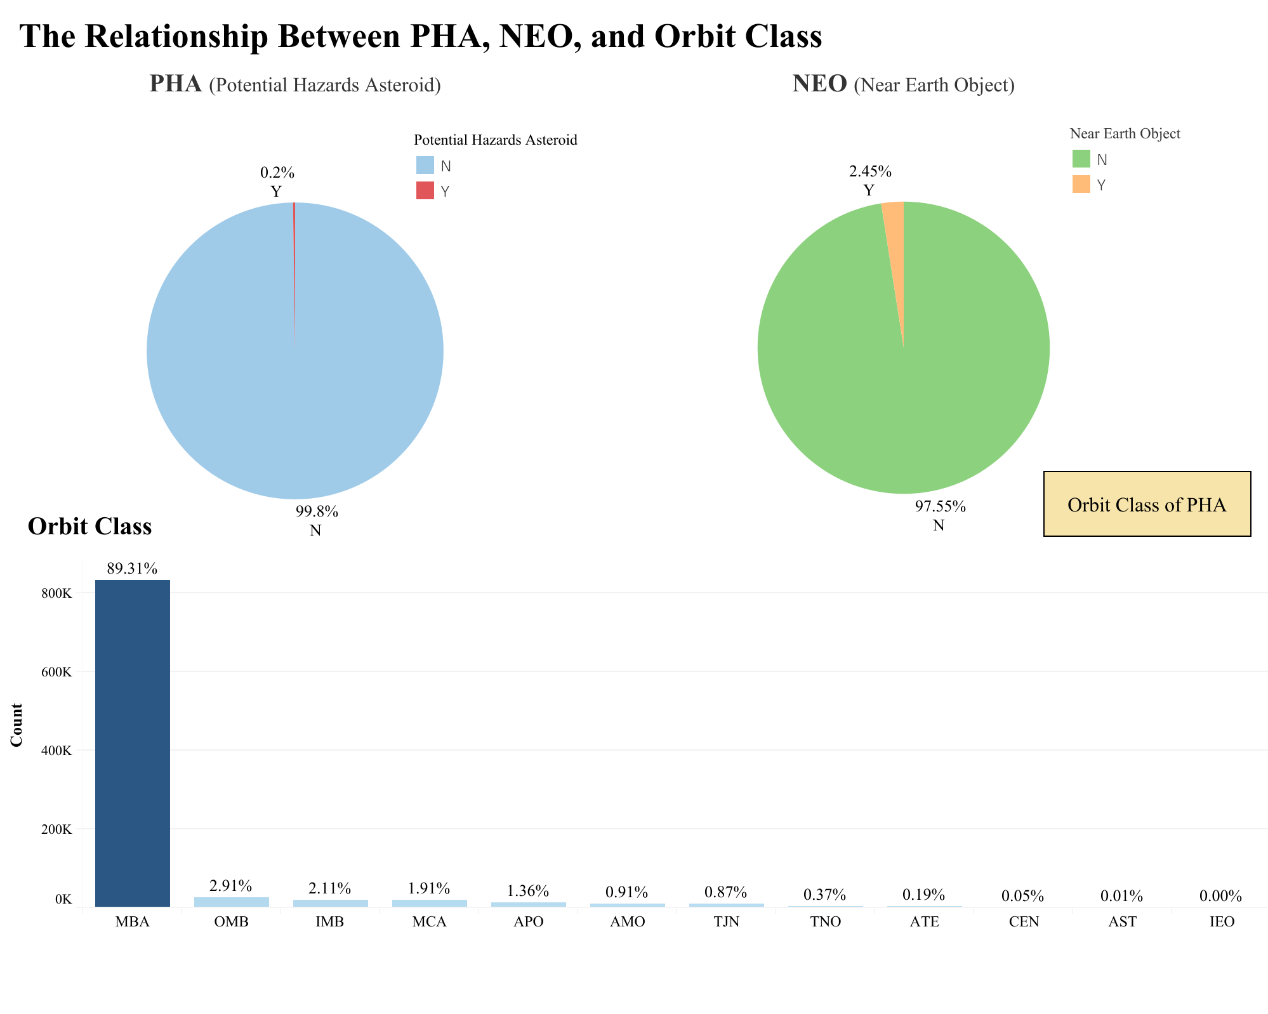
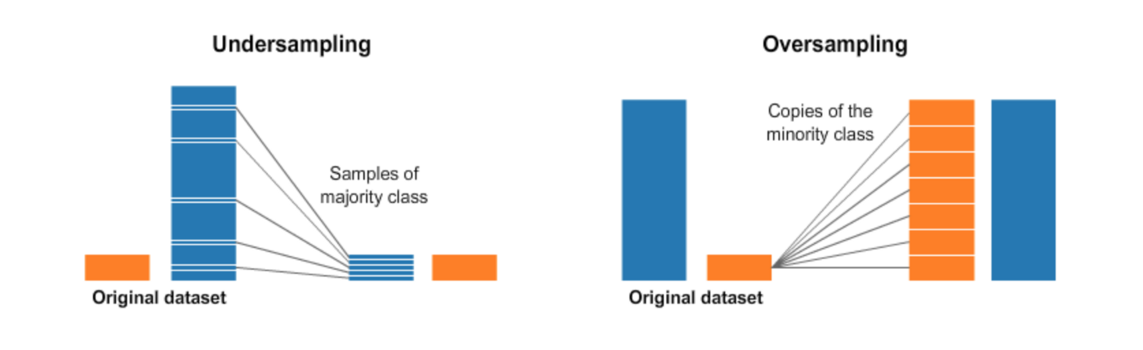
METHODOLOGY
Data Processing
EDA
Handle Identifiers
Encode categorical features and target
Split train, validation, and test set (60/20/20)
Normalize
Handle class imbalance
Upsampling (SMOTE) + Random Undersampling
Categorical Variables
Tableau Public

Slide 8
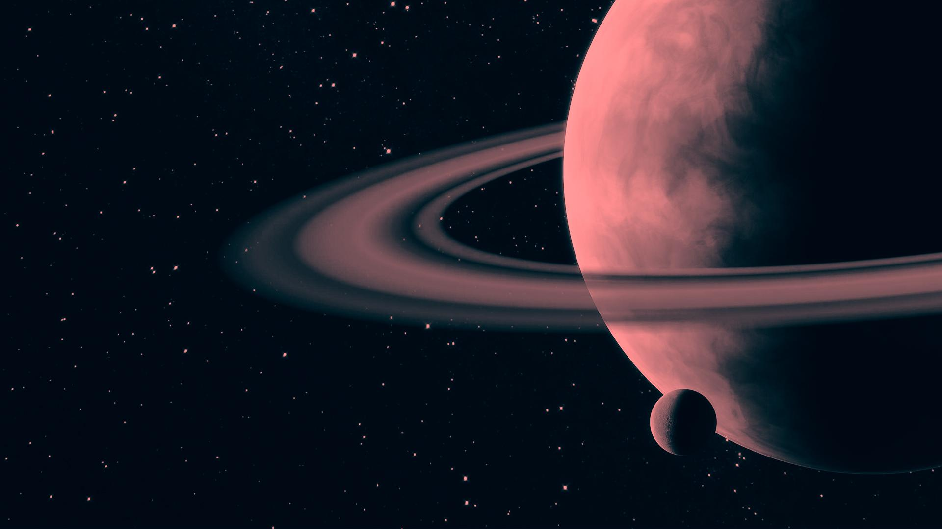
DATA MODELING
7 Machine Learning Model
Why choose these models？
Random Forest
Random forest reduces the overfitting of dataset and increase precision.
XGBoost is fast in training large dataset when compared to other implementations of gradient boosting. It has higher predicting power and performance.
In order to select an optimal model we also tried other models mentioned in the literature review to compare their performance on our dataset.
Recommend in Literature Review
(Ensemble learning)
XGBoost
Decision Tree
Naive Bayes
Logistic Regression
SVM
K-Nearest Neighbors

Slide 9
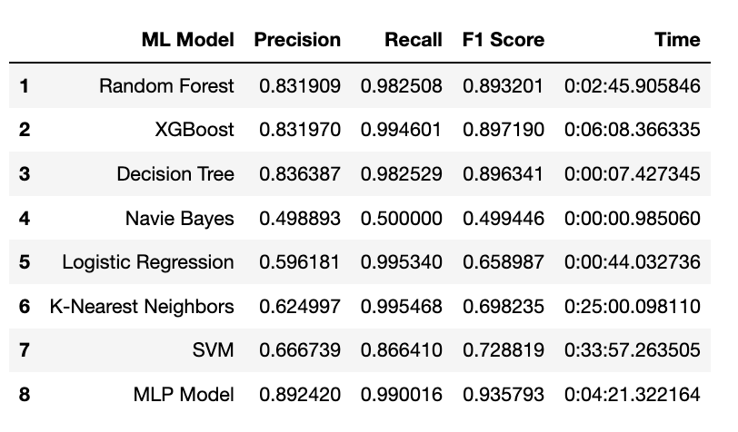
DATA MODELING
What evaluation metrics we chose?
1 Deep Learning Model
With binary classification, it is very intuitive to score the model in terms of scoring metrics such as precision, recall, and f1-score. We decided to use macro-averaging f1-score as metrics to evaluate the model's efficiency.
MLP
Recommend in Literature Review
Model Comparison on Validation Set
Why choose MLP?
MLP has a remarkable ability to derive meaning from complicated or imprecise data can be used to extract patterns and detect trends that are too complex to be noticed by either humans or other computer techniques.

Slide 10
BEST MODEL & VISUALIZATION
Input Layer L1
Hidden
Layer L2-L4
Hidden
Layer L5-L6
Output
Layer L7
X1
X1
X2
X3
MLP
Activity Function: relu
Optimizer: Adam(lr=0.001)
Loss: binary_crossentropy
Metrics: accuracy
X4
Y
. . .
X45
. . .
. . .
10 Neurons
+
Batch Normalization
200 Neurons
+
Batch Normalization
+
Dropout
200 Neurons
+
Batch Normalization

Slide 11
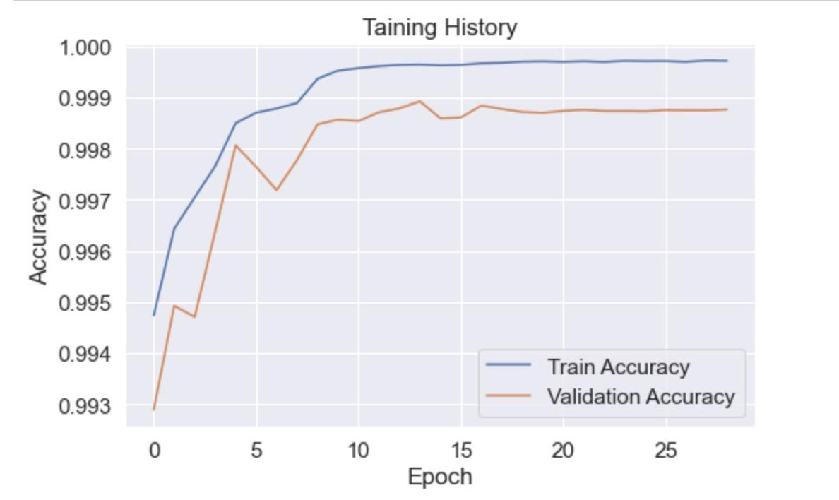
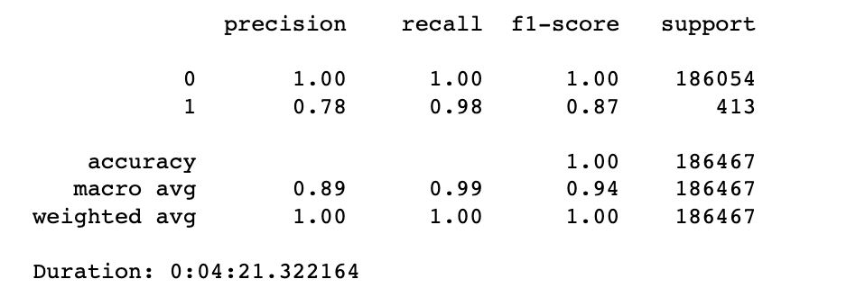
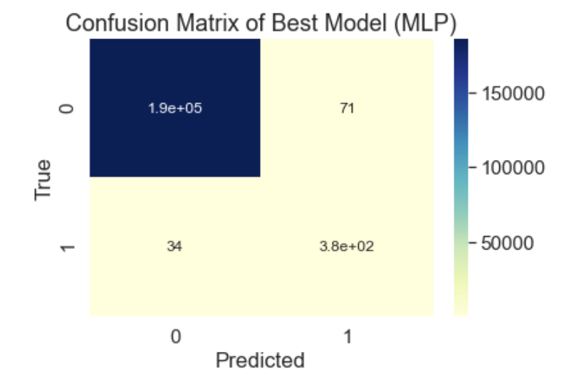
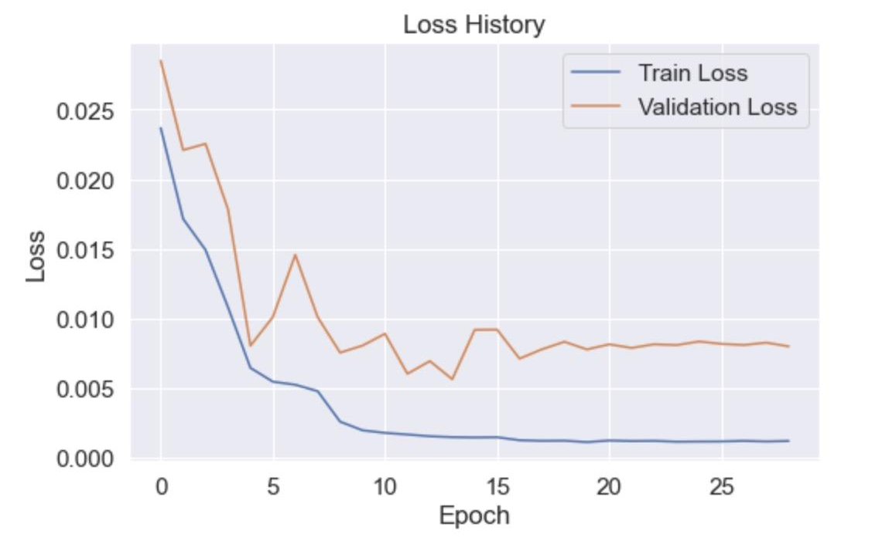
BEST MODEL & VISUALIZATION
Training History
Metrics on Test Set
Confusion Matrix
Loss History

Slide 12
Conclusion
We designed, constructed, and trained a fairly simple neural network to classify asteroids with the potential to impact the Earth in the future. Our method takes the asteroid information (identify elements, size elements, and observed orbital elements) as input and provides a classifier for the expectation value for the object’s striking Earth. Machine learning models can save thousands of person-hours and make automatic processing pipelines in astronomy much more efficient. We found that neural network models have slightly more success than linear and other simple models and have significantly more improvement capacity.
Project Limitation:
Cost Constraint
Data Limitation
Future Research：For future research, we will combine the other data source about the different features and continuously update the model according to the latest data to improve the prediction rate of dangerous asteroids.

Slide 13
REFERENCES
NASA: Asteroids Definition https://solarsystem.nasa.gov/asteroids-comets-and-meteors/asteroids/overview/?page=0&per_page=40&order=name+asc&search=&condition_1=101%3Aparent_id&condition_2=asteroid%3Abody_type%3Ailike
NASA Asteroid Classification
https://towardsdatascience.com/nasa-asteroid-classification-6949bda3b1da
Prediction of Orbital Parameters for Undiscovered Potentially Hazardous Asteroids Using Machine Learning
https://trello.com/c/9mWT7AdD/74-prediction-of-orbital-parameters-for-undiscovered-potentially-hazardous-asteroids-using-machine-learning
A NASA simulation revealed that 6 months' warning isn't enough to stop an asteroid from hitting Earth. We'd need 5 to 10 years
https://www.businessinsider.com/nasa-asteroid-simulation-reveals-need-years-of-warning-2021-5
Identifying Earth-impacting asteroids using an artificial neural network
https://www.aanda.org/articles/aa/full_html/2020/02/aa35983-19/aa35983-19.html
Hazardous Asteroid Classification Through Various Machine Learning Techniques
https://trello.com/c/ueztaNgD/73-si-a-s-2020-hazardous-asteroid-classification-through-various-machine-learning-techniques-international-research-journal-of-engi
Data splitting technique to fit any Machine Learning Model
https://towardsdatascience.com/data-splitting-technique-to-fit-any-machine-learning-model-c0d7f3f1c790
Random Oversampling and Undersampling for Imbalanced Classification
https://machinelearningmastery.com/random-oversampling-and-undersampling-for-imbalanced-classification/
Powerpoint Template
https://slidesgo.com/?utm_source=Slidesgo_template&utm_medium=referral-link&utm_campaign=SG_Credits&utm_term=Freepik

